Slide 1
KDD Cup 98
Student: Thao Le
Mentor: Jamin Atkins
October 2017

Slide 2
Data Introduction
Data set taken from The Second International Knowledge Discovery and Data Mining Tools Competition, held in conjunction with KDD-98 The Fourth International Conference on Knowledge Discovery and Data Mining.
Data set is the Training set used in the competition. It includes:
95412 rows, 481 columns
Each record has a unique identifier, personal attributes, and donation history.
Each record has two target/dependent variables:
TARGET_B: binary variable indicating whether or not the record responded to the promotion of interest ("97NK" mailing)
TARGET_D: contains the donation amount (dollar) and is only observed for those that responded to the promotion.
Objectives:
Predict who are donors (classification problem)
Predict donation amounts for those who are predicted to donate (regression problem)

Slide 3
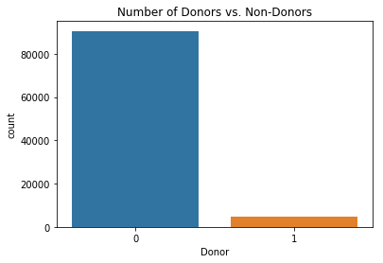
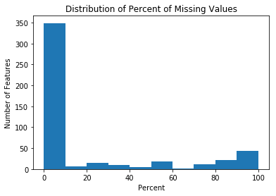
Challenges With the Data Set
Imbalanced data: response rate is only 5%
→ Created a balanced subset, including all records with positive labels and a subset of the records with negative labels
25% of the features have >30% missing values
Dropped all these features
Imputed missing values in the remaining features
Too many features
→ Applied variance threshold and recursive feature elimination for feature selection

Slide 4
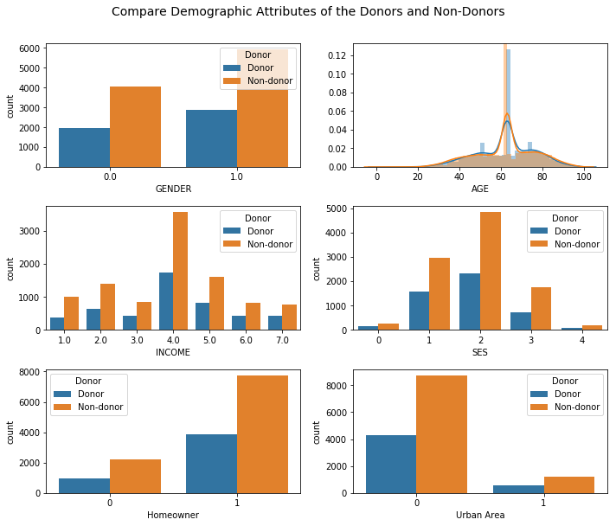
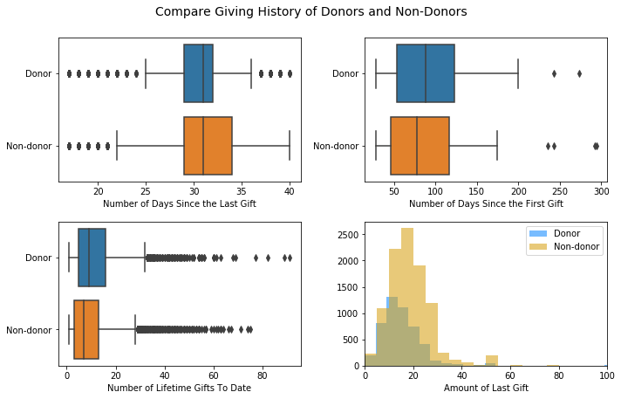
Exploratory Data Analysis
No big differences in demographic attributes and donation history between donors and non-donors

Slide 5
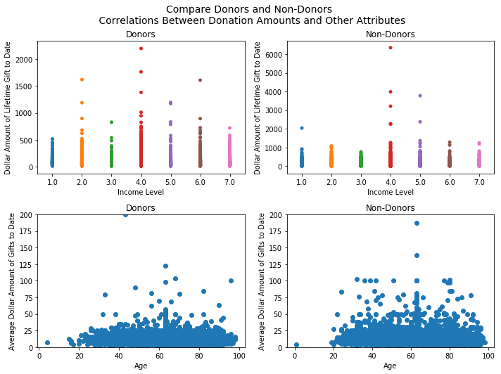
Exploratory Data Analysis (cont.)
Donors seem to have higher total donation amounts to date than non-donors across all income levels.
No correlation between age and average donation amount to date for both donors and non-donors.

Slide 6
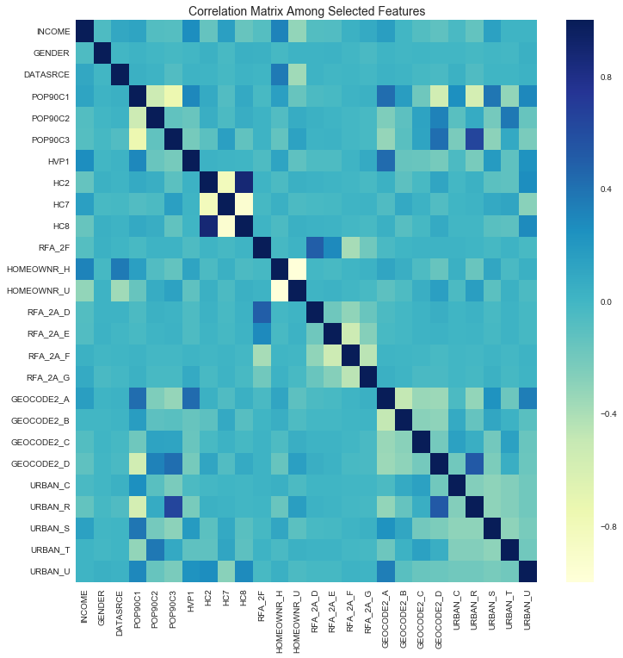
Feature Selection
Feature Selection (Variance Threshold and Recursive Feature Elimination) leads to 26 features in final model.
Low correlation among these features.

Slide 7
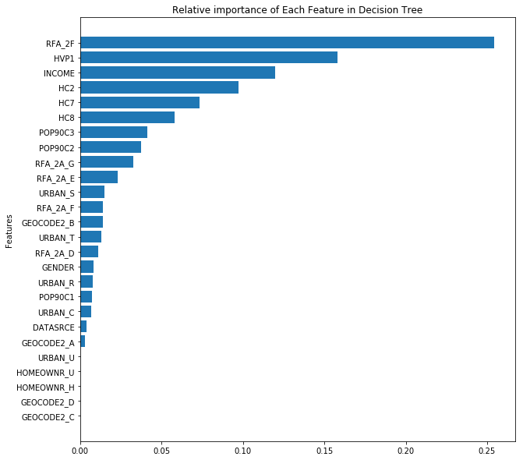
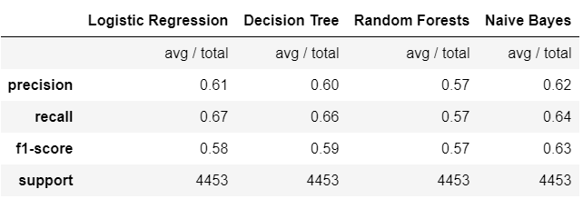
Task 1 – Classify Donors. Vs. Non-Donors
F1 score ranges from 0.57 to 0.63 across all classifiers
Naïve Bayes seems to be the best
Most important features predicted by Decision Tree:
Frequency of donations in most recent period
Percent home value >200k
Income

Slide 8
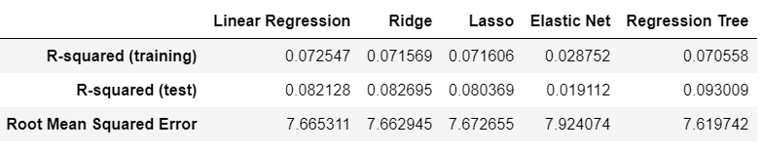
Task 2 – Predict Amount of Donations
Feature Selection (Variance Threshold & RFE) again to select the best features needed for regression task → 7 features selected.
Overall low R-squared across all models (range from 0.02 to 0.09)
Regression Tree seems to be the best.
Amount of most recent donation (RFA_2A_D & RFA_2A_G) are predicted to be the most important features by all models.

Slide 9
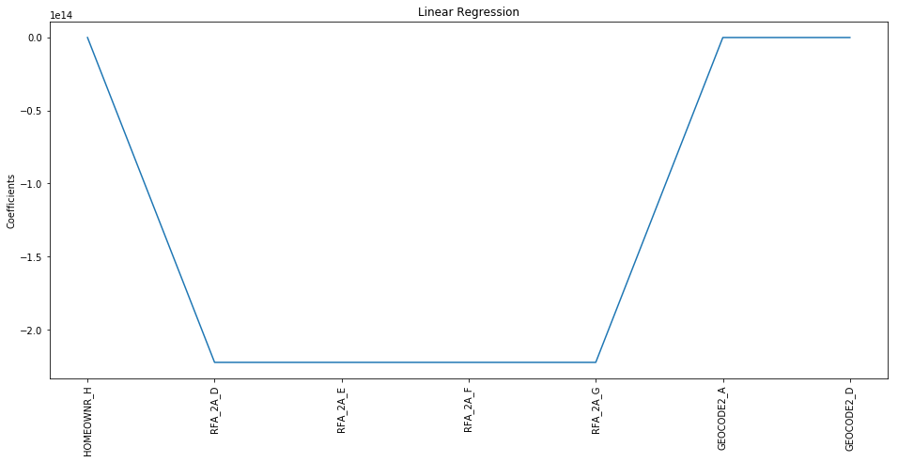
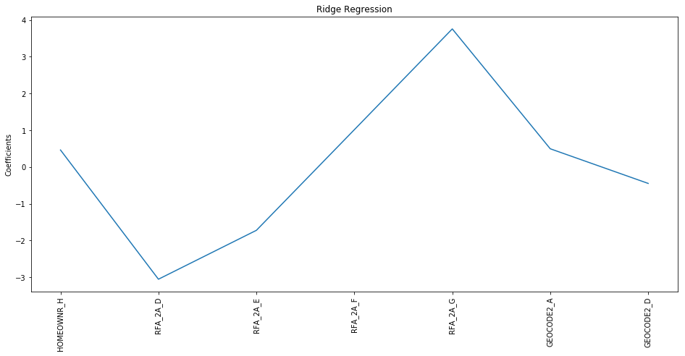
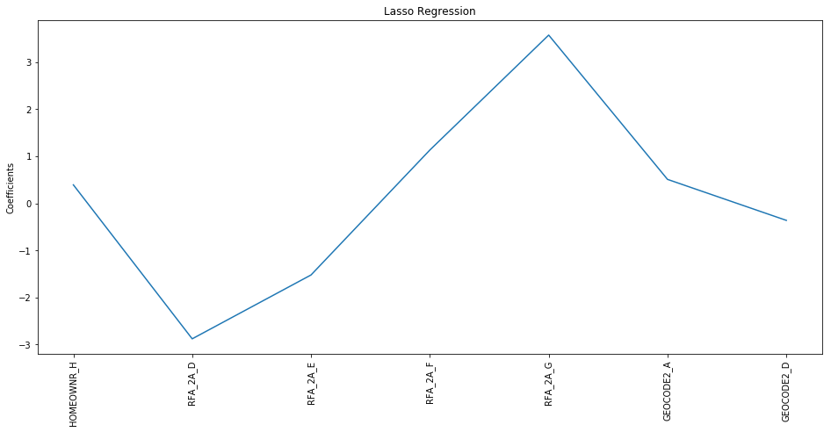
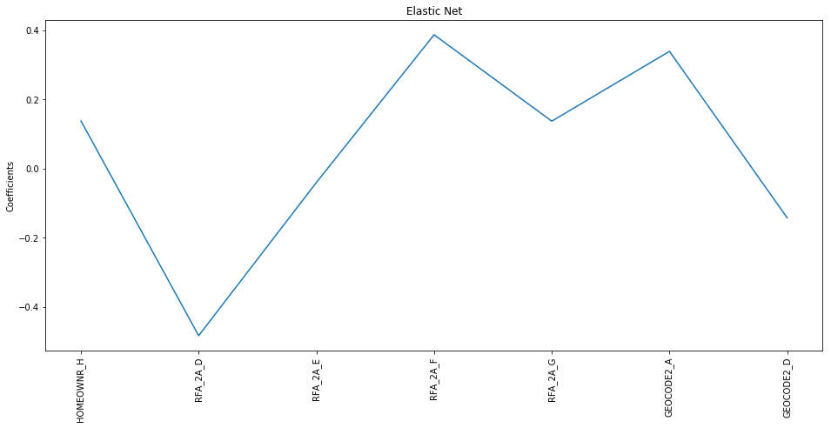
Compare Importance of Coefficients Across Regression Models

Slide 10
Concluding Remarks
Feature Selection is the most important part of this project…
… Even if I tried different methods for feature selection and reduction (Variance Threshold, RFE, Select Kbest, SelectPercentile, PCA), I couldn’t spot an optimal set of variables for both the classification and regression tasks.
Creating a balanced subset was very useful…
… Otherwise all of my classifiers would not be able to predict any positive cases due to the overwhelming number of negative cases.
In the regression task, all models have very low R-squared…
… However, R-squared would improve if I included more positive cases in the balanced subset (i.e., if the ratio of donors vs. non-donors is 1:1).
… Again, this goes back to the issue of feature selection.

